Slide 1
CAPSTONE PROJECT
PRESENTED BY :JEEN SUVITHA.D
3/21/2024 Annual Review

Slide 2
PROJECT TITLE
HOTEL BOOKING ANALYSIS
3/21/2024 Annual Review

Slide 3


AGENDA
PROBLEM STATEMENT
PROJECT OVERVIEW
WHO ARE THE END USERS
YOUR SOLUTIONS AND ITS VALUE PROPOSITION
THE WOW IN YOUR SOLUTION
MODELLING
RESULTS
3/21/2024 Annual Review

Slide 4

PROBLEM STATEMENT
Have you ever wondered when the best time of year to book a hotel room is? Or the optimal length of stay in order to get the best daily rate? What if you wanted to predict whether or not a hotel was likely to receive a disproportionately high number of special requests? This hotel booking dataset can help you explore those questions! This data set contains booking information for a city hotel and a resort hotel, and includes information such as when the booking was made, length of stay, the number of adults, children, and/or babies, and the number of available parking spaces, among other things. All personally identifying information has been removed from the data. Explore and analyse the data to discover important factors that govern the bookings.
3/21/2024 Annual Review

Slide 5

PROJECT OVERVIEW
The primary objective of this project is to analyze hotel bookings data, specifically focusing on cancellations and their underlying patterns. By understanding these patterns, we can suggest measures that hotel owners can implement to reduce cancellations and secure revenue.
Here are the key points covered in this analysis:
Dataset Introduction
Cancellation Trends
Topics Studied
Recommendations
3/21/2024 Annual Review

Slide 6

WHO ARE THE END USERS?
In the context of hotel booking analysis, the end users typically include:
Hotel Owners and Managers
Revenue Managers
Marketing Teams
Customer Service Representatives
Data Analysts and Data Scientists
3/21/2024 Annual Review

Slide 7

YOUR SOLUTION AND ITS VALUE PROPOSITION
Solution and its value propositions in hotel booking analysis.
Solution Overview:
Our comprehensive analysis provides actionable insights for hotel owners, managers, and revenue teams.
We focus on understanding cancellation patterns, pricing strategies, and guest preferences.
Value Propositions:
Optimized Cancellation Policies:
Revenue Enhancement
Platform Insights
Guest Segmentation
Yearly Trends
In summary, our solution empowers stakeholders with data-driven decisions, leading to improved revenue, guest satisfaction, and operational efficiency.
3/21/2024 Annual Review

Slide 8

THE WOW IN YOUR SOLUTION
Let’s explore the wow factor in our hotel booking analysis solution:
Predictive Personalization:
Our solution goes beyond basic analysis by predicting individual guest preferences.
By analyzing historical data, we can recommend personalized experiences for each guest.
Imagine a guest receiving a room upgrade or a personalized welcome package based on their past behavior.
Dynamic Pricing Algorithms:
Our algorithms adjust room rates in real time based on demand, seasonality, and other factors.
Guests benefit from competitive prices, while hotels maximize revenue.
Picture a guest booking a room at the perfect price, tailored to their booking time and length of stay.
3/21/2024 Annual Review
8

Slide 9
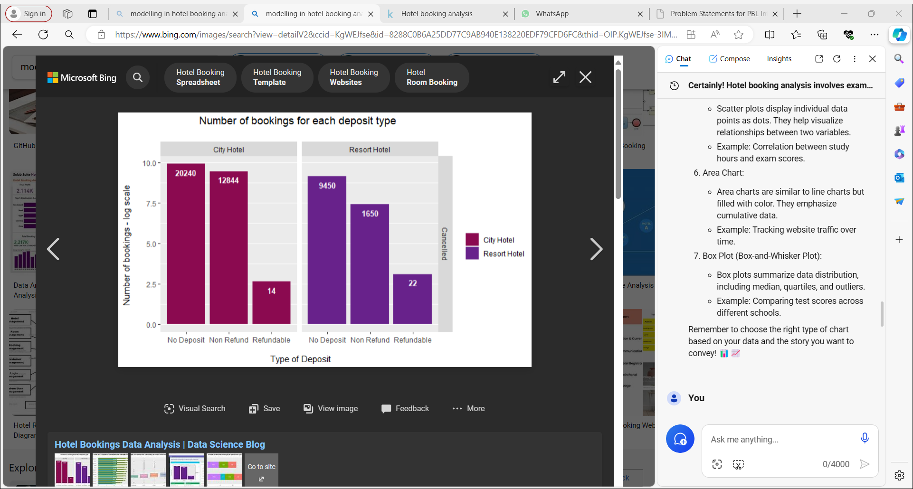
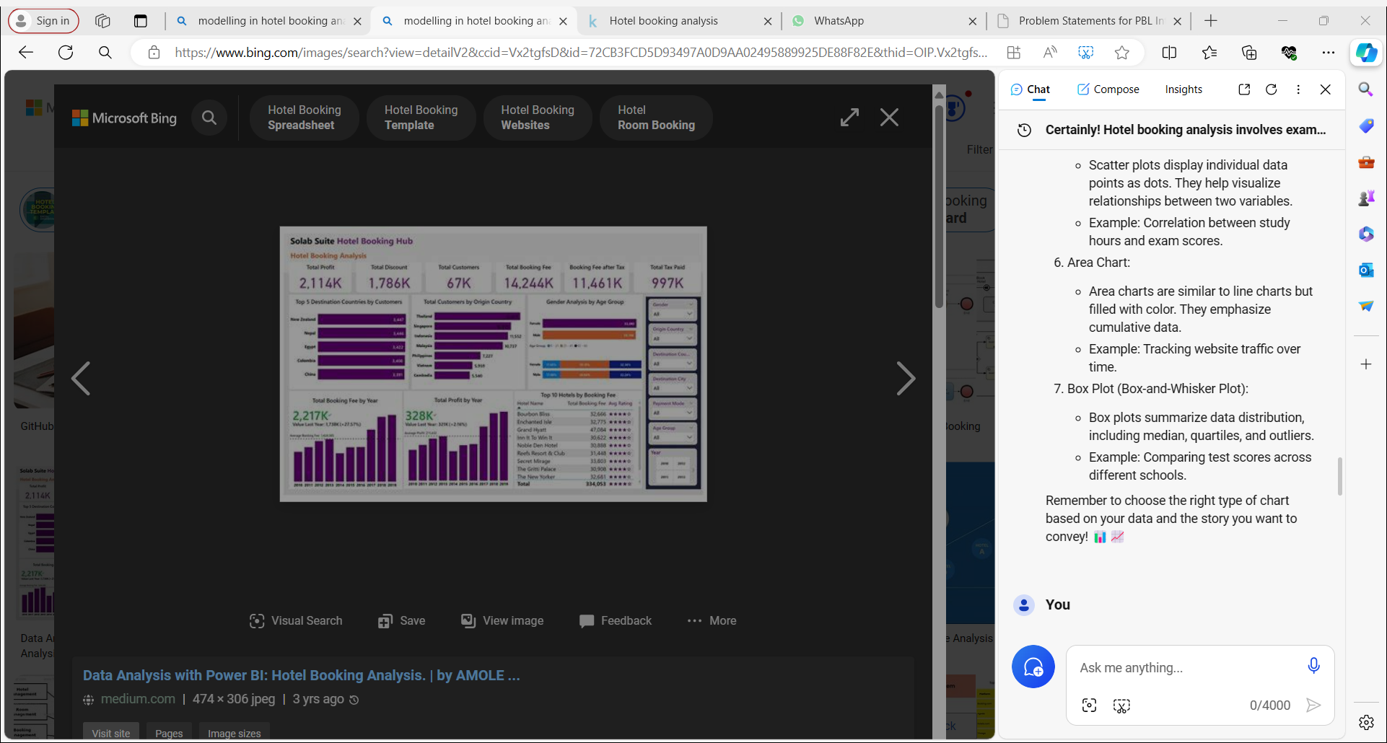
MODELLING
Teams cam add wireframes
3/21/2024 Annual Review
9

Slide 10
RESULTS
Let’s delve into the results of hotel booking analysis based on the available data. Here are some key insights:
Cancellation Patterns:
Average Daily Rates (ADR)
Guest Behavior Insights
Additional Measures to Reduce Cancellations
Remember that these insights can inform decision-making and help hotel owners enhance revenue and guest satisfaction
Demo Link
3/21/2024 Annual Review
10

